Slide 1

Elementary and Secondary School Emergency Relief (ESSER) Roundtable Series
Effective Virtual/Remote Instruction and Planning
New Jersey Department of Education
Division of Educational Services
February 15, 2023
Notes:
Anthony

Slide 2
Agenda
Housekeeping Ms. Peggy Porche, Planning Associate
Office of the Executive Director/Deputy Assistant
Commissioner
Greetings/Welcome Dr. A. Charles Wright,
Executive Director/Deputy Assistant Commissioner
Division of Educational Services
ARP ESSER Website Update Mr. Clark Coe, Jr.
Project Specialist, Office of the Executive Director/Deputy
Asst. Commissioner
Effective Virtual/Remote Instruction and Planning Mr. Gilbert Gonzales, Director
Office of Innovation
Division of Teaching and Learning
Monmouth Ocean Ed. Services Dr. Wendy Gray Morales
Assistant Superintendent
Notes:
Anthony

Slide 3

Using Microsoft Teams
  Chat
    We welcome your participation in discussions by asking questions and adding comments in the chat box.
  Raise Hand
  Please use the raise hand feature if you want to speak.
  Mute/Unmute
    Please remain muted whenever you are not speaking.
Notes:
Peggy

Slide 4
Greetings/Welcome
Dr. A. Charles Wright
Executive Director/Deputy Assistant Commissioner
Division of Educational Services
Notes:
Kathy
The next few slides review the allowable uses of the ESSER funds.
Next slide

Slide 5
ARP ESSER Website Update
Mr. Clark Coe, Jr
Project Specialist.
Office of the Executive Director/Assistant Commissioner
Notes:
Kathy
The next few slides review the allowable uses of the ESSER funds.
Next slide

Slide 6
Effective Virtual/Remote Instruction and Planning
Mr. Gilbert Gonzales, Director
Office of Innovation
Division of Teaching and Learning
Notes:
Kathy
The next few slides review the allowable uses of the ESSER funds.
Next slide

Slide 7
Team Introduction
Gilbert Gonzalez, Director
  Linda Smith, Administrative Assistant
  Mayra Bachrach, Computer Science Innovation Specialist
  Mike Buttitta, STEAM Innovation Specialist
  Chris Cox, Educational Technology Innovation Specialist
  Swati Chauhan, Climate Awareness Innovation Specialist
  Ross Gary, Climate Awareness Innovation Specialist
  Jessica Valenti, Climate Awareness Innovation Specialist
Notes:
Good morning, I’m excited to share some of the great work that’s coming out of the Office of Innovation with you this morning. The innovation team consists of:
Gilbert Gonzalez, Director
Linda Smith, Administrative Assistant
Mayra Bachrach, Computer Science Innovation Specialist
Mike Buttitta, STEAM Innovation Specialist
Chris Cox, Educational Technology Innovation Specialist
Swati Chauhan, Climate Awareness Innovation Specialist
Ross Gary, Climate Awareness Innovation Specialist
Jessica Valenti, Climate Awareness Innovation Specialist

Slide 8
Office Overview
The Office of Innovation is charged with advancing and supporting the implementation of the New Jersey Student Learning Standards (NJSLS) in Computer Science, Design Thinking, and Climate Change and supporting innovative instructional practices across all content areas.
  The innovation team supports the expansion of high-quality educational experiences for students across the state by building the capacity of New Jersey’s educators to deliver innovative, relevant, and engaging instruction aligned to the NJSLS incorporating the latest advancements in educational technology.
Notes:
Among its responsibilities, the Office of Innovation is charged with advancing and supporting the implementation of the New Jersey Student Learning Standards in Computer Science and Design Thinking (NJSLS-CS-DT), as well as the climate awareness elements of our state standards, which are integrated across all content areas.
Our team collaborates extensively with our colleagues in the Office of Standards and supports the expansion of high-quality, engaging, and relevant educational opportunities for all students. We do this by promoting and supporting the integration of cutting-edge educational technologies into instruction to create new experiences for students, and by using climate awareness and sustainability as a lens for making real-world connections to science, technology, engineering, arts, and mathematics (STEAM), as well as computer science.

Slide 9
2022-2023 Priorities
The Innovation Team is currently engaged in exciting research and development work in the following areas:
  Identification of innovative instructional practices incorporating cutting edge educational technologies.
  Engagement with the field to support landscape analysis.
  Collaboration with the Office of Standards to develop NJSLS-Computer Science, Design Thinking, and Climate Change resources and professional development.
  Continued work toward the strategic goals of the Computer Science for All State Plan.
  Revision of the field engagement strategy for promotion of the work coming out of Computer Science State Hubs.

Slide 10
2022-2023 Grant Opportunities
For the 2022-2023 school year, the innovation team will be focused on the administration of grant opportunities in the amount of $2 million for computer science and $5 million for climate awareness which are made possible through funding in Governor Murphy’s FY23 state budget.
  The innovation team is concurrently managing the administration of existing computer science related grant opportunities supported by appropriations in the FY21 ($800,000) and FY22 ($2 million) state budgets.
  The FY23 appropriation for climate awareness will support the addition of Climate Awareness Innovation Specialists to the innovation team, as well as exciting new opportunities for student-centered activities and educator supports for implementing the integrated climate awareness elements of the NJSLS.
Notes:
The Office of Innovation oversees the administration of grant opportunities in the amount of $2 million for computer science and $5 million for climate change which are made possible through funding in Governor Murphy’s state budget. This work will support the expansion of high-quality educational experiences for students across the state by building the capacity of New Jersey’s educators to deliver innovative, relevant, and engaging instruction aligned to the NJSLS.

Slide 11
Computer Science Grant Programs (1 of 2)
The Professional Learning Computer Science (CS) Hubs at Montclair State University, Richard Stockton University, and the College of New Jersey.
  Professional learning in computer science for K-12 educators aligned with the New Jersey Student Learning Standards in Computer Science (NJSLS-CS)
  Stipends for educators attending professional learning outside of school hours.
  Small physical computing devices for educators attending related professional learning workshops.
  Reimbursement for students’ Advanced Placement exam fees for a school from partner school districts offering Advanced Placement Computer Science A or Computer Science Principles for the first time.
Notes:
State-funded programs were established at four New Jersey institutions of higher education to provide computer science professional learning, support the implementation of the 2020 New Jersey Student Learning Standards in Computer Science (NJSLS-CS), and promote the expansion of K-12 computer science education. School districts and schools are encouraged to make use of the services and resources available.
The grant period for the programs end on March 31, 2023.
The Computer Science (CS) Hubs at Montclair State University, Richard Stockton University, and the College of New Jersey offer the following services:
Professional learning in computer science for K-12 educators aligned with the New Jersey Student Learning Standards in Computer Science (NJSLS-CS)
Stipends for educators attending professional learning outside of school hours.
Small physical computing devices for educators attending related professional learning workshops.
Reimbursement for students’ Advanced Placement exam fees for a school from partner school districts offering Advanced Placement Computer Science A or Computer Science Principles for the first time.

Slide 12
Computer Science Grant Programs (2 of 2)
New Jersey Student Learning Standards in Computer Science (NJSLS-CS) Support Programs at Fairleigh Dickinson University and Montclair State University:
  Opportunities for educators to participate in working groups to create and curate resources to support the implementation of the NJSLS-CS for grades K-8.
  Stipends for educators attending professional learning events outside of school hours.
  Professional learning for grades K-8 educators aligned with the NJSLS-CS.
  Classroom resources to support the implementation of the NJSLS-CS.
Notes:
State-funded programs were established at Fairleigh Dickinson University and Montclair State University to support the implementation of the New Jersey Student Learning Standards in Computer Science (NJSLS-CS). The services provided by the programs include:
Opportunities for educators to participate in working groups to create and curate resources to support the implementation of the NJSLS-CS for grades K-8.
Stipends for educators attending professional learning events outside of school hours.
Professional learning for grades K-8 educators aligned with the NJSLS-CS.
Classroom resources to support the implementation of the NJSLS-CS.

Slide 13
Computer Science (CS) Hubs
Central New Jersey Hub at The College of New Jersey (TCNJ): https://www.centralnjcshub.org/ (https://tinyurl.com/njcentralcshub)
Coastal Hub at Richard Stockton University: https://stockton.edu/ettc/cscoastal.html (https://tinyurl.com/njsouthcshub)
North New Jersey Hub at Montclair State University:
https://www.montclair.edu/computer-science-education/computer-science-education-hub/ (https://tinyurl.com/njnorthcshub)
Notes:
Please visit the programs’ websites for additional information.

Slide 14
NJSLS-CS Support Programs
NJSLS-CS Support Program at Fairleigh Dickinson University:
https://sites.google.com/view/fducsforall (https://tinyurl.com/njsls-csfdu)
NJSLS-CS Support Program at Montclair State University:
https://www.montclair.edu/computer-science-education/computer-science-for-everyone-everywhere/ (https://tinyurl.com/njsls-csmsu)
Notes:
Please visit the programs’ websites for additional information.

Slide 15
Thank You!
Thank you for your time and attention during part 3 of this webinar series. We encourage you to continue your professional learning by viewing parts 1 and 2 of this series.
Part 1 focuses on the mission, vision, and spirit and intent of the New Jersey Student Learning Standards for Climate Change Education.
Part 2 discusses the integration of Diversity, Equity, and Inclusion and Learning Acceleration into climate awareness instruction.
The Department of Education is here to support you in your efforts to implement the 2020 New Jersey Student Learning Standards and the legislative mandates. Please feel free to reach out to us via email at innovation@doe.nj.gov.
https://www.nj.gov/education/innovation/innovation/doe.nj.gov
Follow Us!
Facebook:
@njdeptofed
Twitter: @NewJerseyDOE
Instagram:
@NewJerseyDoe
Notes:
Thank you for your time and attention during part 3 of this webinar series. We encourage you to continue your professional learning by viewing parts 1 and 2 of this series.
Part 1 focuses on the mission, vision, and spirit and intent of the New Jersey Student Learning Standards for Climate Change Education.
Part 2 discusses the integration of Diversity, Equity, and Inclusion and Learning Acceleration into climate awareness instruction.
The Department of Education is here to support you in your efforts to implement the 2020 New Jersey Student Learning Standards and the legislative mandates. Please feel free to reach out to us via email at innovation@doe.nj.gov.

Slide 16
District Presentations

Slide 17
Monmouth-Ocean Educational Services Commission
Dr. Wendy Gray Morales
Assistant Superintendent
Notes:
Anthony

Slide 18


Supplement Your District’s Programs with
Wendy Gray Morales, Ed.D. Assistant Superintendent
Monmouth-Ocean Educational Services Commission
900 Green Grove Road, Tinton Falls, NJ 07712
(732) 695-7800 www.moesc.org

Slide 19
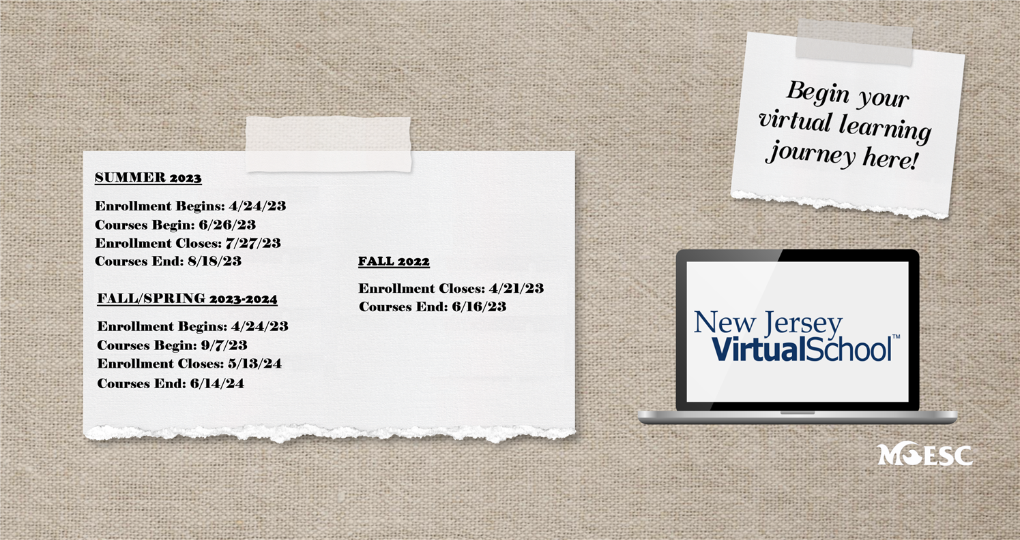
What is an Educational Services Commission(ESC)?
MOESC is the ESC that oversees the NJ Virtual School
An ESC is a public, non-profit organization which provides programs and services to school districts and collaborates with other commissions and organizations throughout the state of New Jersey.
*There are 9 ESCs in NJ

Slide 20

What is NJ Virtual School?
Online, asynchronous courses for students in grades 6-12
Courses facilitated by NJ certified teachers employed & evaluated by MOESC
D2L, Edmentum & APEX platforms used for course delivery (Maestro is our SIS)
Content can be translated into 19 languages for ELLs
Most 504 and IEP accommodations & modifications built into the platform (others the teachers will provide)
Credits approved and awarded by school district under OPTION 2 (https://docs.google.com/document/d/1PKQUq8DPa4n0rfIrOI4CJRC8e_ivpXgJKtRtK8J6kac/edit) (N.J.A.C.6A:8-5.1(a)1ii, permits district boards of education to establish curricular activities or programs aimed at achieving the NJSLS for promotion and graduation purposes. Option 2 serves as an alternative to traditional high school courses.)
Cannot issue diploma due to NJ laws

Slide 21
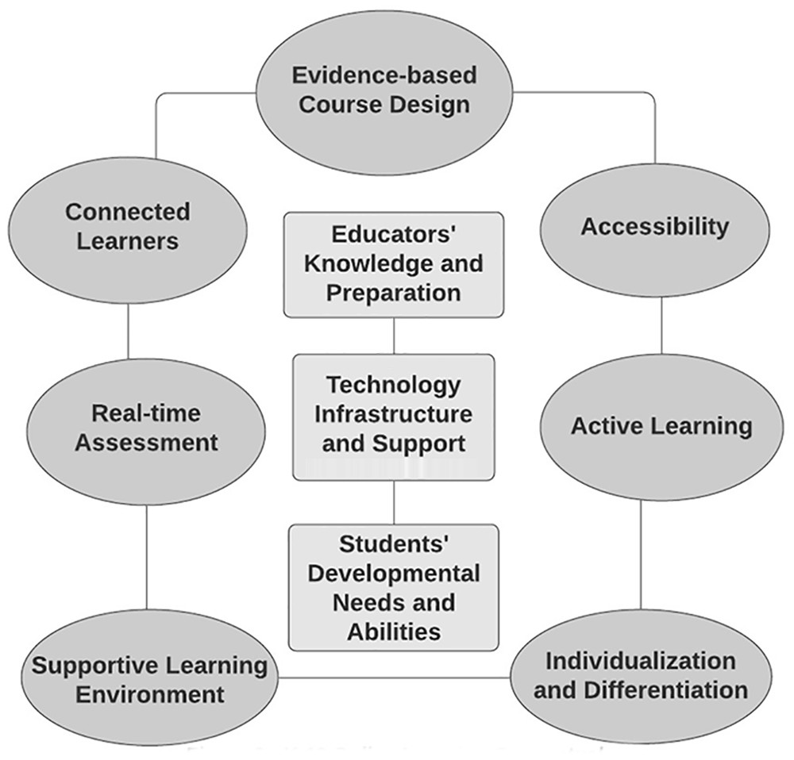
The Research Related to Online Learning
“Outside of the context of COVID-19, research findings suggest that students can perform equally well in online environments as they do in face-to-face settings (e.g., Patrick & Powell, 2009). Means et al. (2013) found in their meta-analysis of 99 empirical studies encompassing learners aged 13 to 44 that students in online courses performed at least as well as their peers in face-to-face courses.”
Essential instructional components for K–12 learning
in online education settings

Slide 22
Our Teachers’ Certifications
Art
Biological Science
Business: Comprehensive Business
Business: Computer Applications and Business-Related Information Technology
Business: Finance/Economics/Law
Chemistry
Driver Education
Earth Science
Elem School w/Subject Matter Specialization (Math, ELA & Social Studies)
English
English as a Second Language
French
Health and Physical Education
Mathematics
Music
Physical Science
Psychology
Social Studies
Spanish
Students with Disabilities
Teacher of Computer Science Technology
Technology Education
Teacher of The Handicapped
This list continues to grow as our enrollment grows!
Course Catalog
(https://www.njvs.org/Page/101)

Slide 23
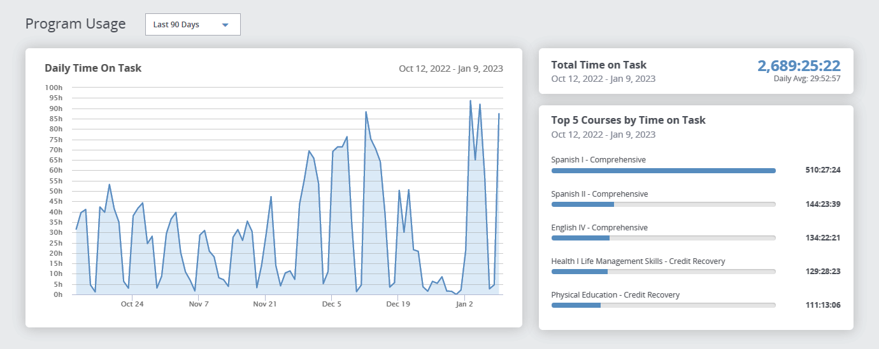
Our Data

Slide 24

What Sets NJVS Apart
Designated Principal
Designated Curriculum Director
Designated Secretary
Personalized Technical Support (24 hours a day, 7 days a week)
95% Pass Rate (Most recent semester’s data)
Managed by NJ public school administrators for a non-profit organization (MOESC!)
Flexibility to meet your district’s specific needs

Slide 25
Examples of How We Meet District Needs
Online Spanish courses while teacher awaits certification (substitute teacher in physical classroom)
Personal Financial Literacy for entire school to fulfill grad requirement (substitute, specialist, or other staff supervise students in classroom or used in “study hall”)
Individual students with special needs including school phobia
Credit recovery while students continue their in-district coursework
Advanced/unique courses school cannot offer due to low enrollment
Hard to fill certifications
Dual enrollment options

Slide 26

New Partnerships
Ocean County College Virtual Scholars Program
Brookdale Middle College Program

Slide 27
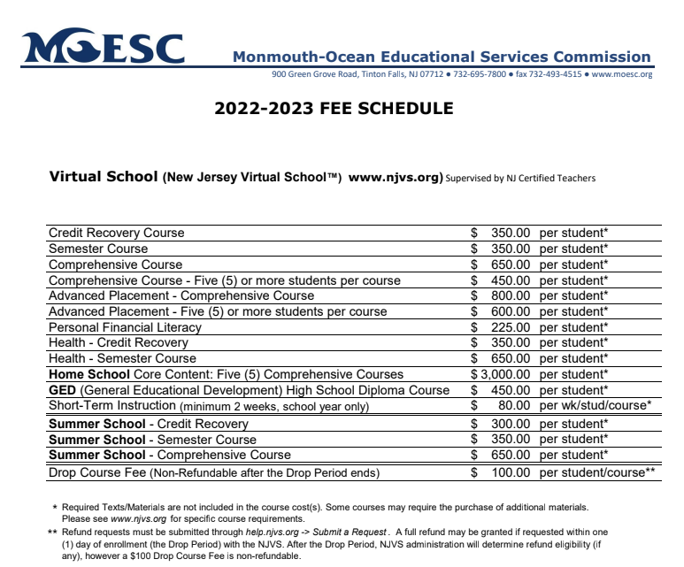
Cost
Cost Comparison Example:
Teacher in-district with 6 sections of Spanish I = $100,000 (salary & benefits)
____________________________________
NJVS Spanish I for 120 students = $30,000 (discounts given for large numbers of students in one course)
Includes:
Learning Platform
Certified Teacher
Technology Support

Slide 28

New for 22-23: MOESC Professional Development Series
Upcoming Sessions:
2/16: Low Floor, High Ceiling Activities for Engaging Students in Learning Mathematics
2/23: Get Started with Blended Learning & Create Your Own Teacher Toolbox
3/7: Designing Units That Foster Student Engagement
3/14: Using Data to Increase Productive School Performance
3/30: Professional ChromeOS Administrator Certification Camp
In-person PD on a variety of topics
Highly qualified practitioners as presenters
Personalized PD based on district’s unique needs
Partnered with Google for Education to provide educational technology training at a discounted rate
moesc.org/pd

Slide 29
Questions and Contact
Contact Information
@NJVirtualSchool
njvs.org
@MOESCnj
moesc.org
Wendy Gray Morales, Ed.D.
wmorales@moesc.org
@DrGrayMorales
732-6957833

Slide 30
Thank You!
New Jersey Department of Education Website
nj.gov/education
Questions may be submitted to:
ESSER@doe.nj.gov
Registration now open for the March 22, 2023, ARP ESSER Round Table at
https://homeroom5.doe.state.nj.us/events/
Follow Us!
Facebook:
@njdeptofed
Twitter: @NewJerseyDOE
Instagram:
@NewJerseyDoe
Notes:
Anthony

